Slide 1
Statistical Analysis on Rate parameters of H2-O2 reaction system

Slide 2
Background
There have been a few studies on reaction mechanism optimization against various experiments:
GRI_Mech
USC Mech II (Hai Wang et al), MUM_PCE (David Sheen and Hai Wang) → A factor optimization
Aramco Mech related (Turanyi and Curran)
Previous optimizations are empirical uncertainty parameter on each reaction and performed against:
Flow reactor speciation time history
Shock tube speciation time history
Laminar Flame speed
Jet stirred reactor speciation temperature profile
Shock tube ignition delay time
Main issues of previous work:
No solid base for the assigned uncertainty of the reaction, largely on personal experience/bias
Optimization rates against the following is not valid.
Laminar Flame speed → errors/uncertainty due to manifold of transport and rate in large temperature range
Jet stirred reactor speciation temperature profile→ mixing issue (IS it rapid enough? New/fresh fuel mixed with others which have already reacted for certain time
Shock tube ignition delay time → large uncertainty due to impurity and pressure variation from boundary layer and heat release
Our approach:
Collect all rates determined from shock tube/flow reactor speciation time history with known uncertainty, modern theoretical calculation results included too with assigned uncertainty if experimental data are sparse
Evaluate rate uncertainty at each temperature/pressure based statistical analysis (weighted average)
Weighted least square fitting all evaluated rates of this reaction to generate Arrhenius parameters(Troe formula)
Construction the mechanism using rate parameters with uncertainty on A, n and E
Simulations against experimental speciation time history profile to further refine the mechanism with MUM-PCE. A reinterpret the experiments with new understanding.
Main advantages: 1) free of personal preference/bias. Objective and automated. 2) robust statistical base and can evolve with new data flowing in

Slide 3



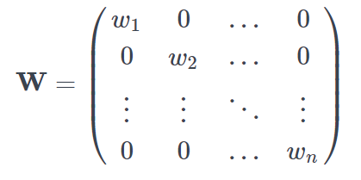
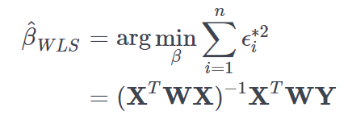

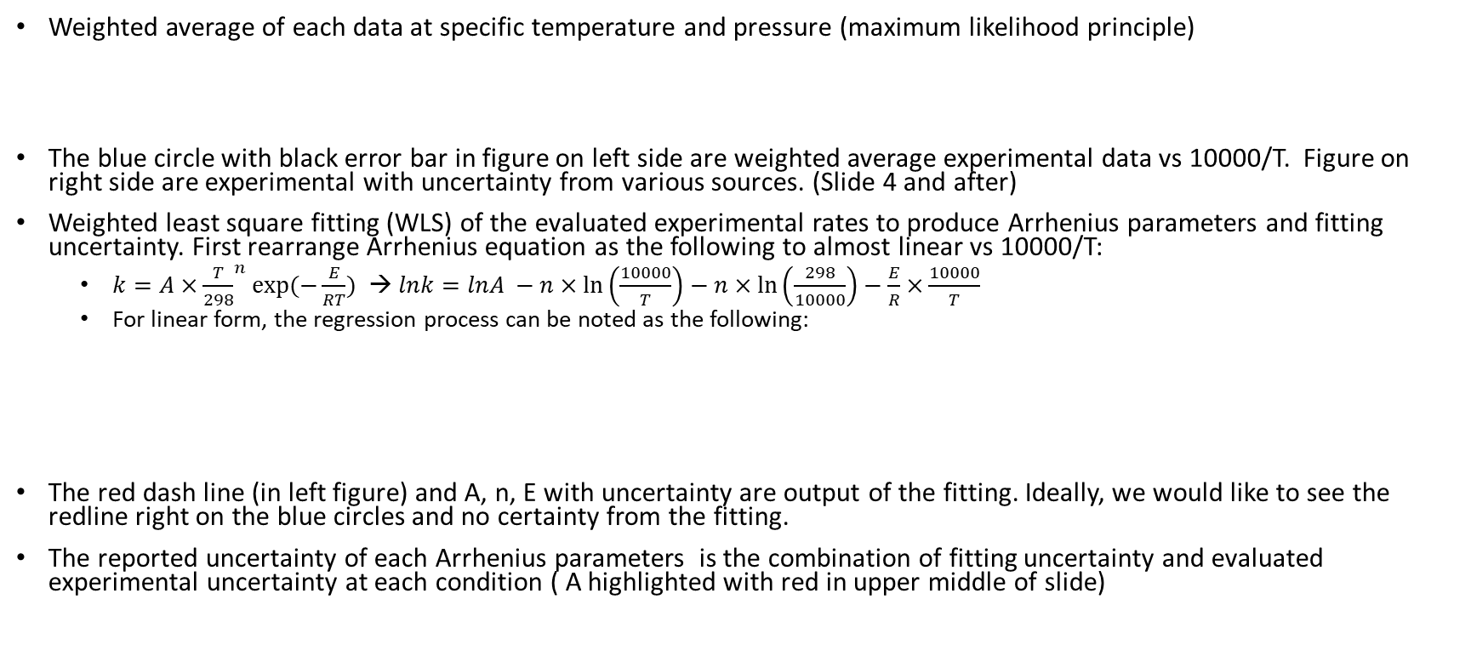
Weighted average and least square fitting
Weighted average of each data at specific temperature and pressure (maximum likelihood principle)
The blue circle with black error bar in figure on left side are weighted average experimental data vs 10000/T. Figure on right side are experimental with uncertainty from various sources. (Slide 4 and after)
Weighted least square fitting (WLS) of the evaluated experimental rates to produce Arrhenius parameters and fitting uncertainty. First rearrange Arrhenius equation as the following to almost linear vs 10000/T:
$k=A×{\frac{T}{298}}^{n}exp⁡(−\frac{E}{RT})$ → $lnk=lnA −n×\ln\left(\frac{10000}{T}\right)−n×\ln\left(\frac{298}{10000}\right)−\frac{E}{R}×\frac{10000}{T}$
For linear form, the regression process can be noted as the following:
The red dash line (in left figure) and A, n, E with uncertainty are output of the fitting. Ideally, we would like to see the redline right on the blue circles and no certainty from the fitting.
The reported uncertainty of each Arrhenius parameters is the combination of fitting uncertainty and evaluated experimental uncertainty at each condition ( A highlighted with red in upper middle of slide)

Slide 4
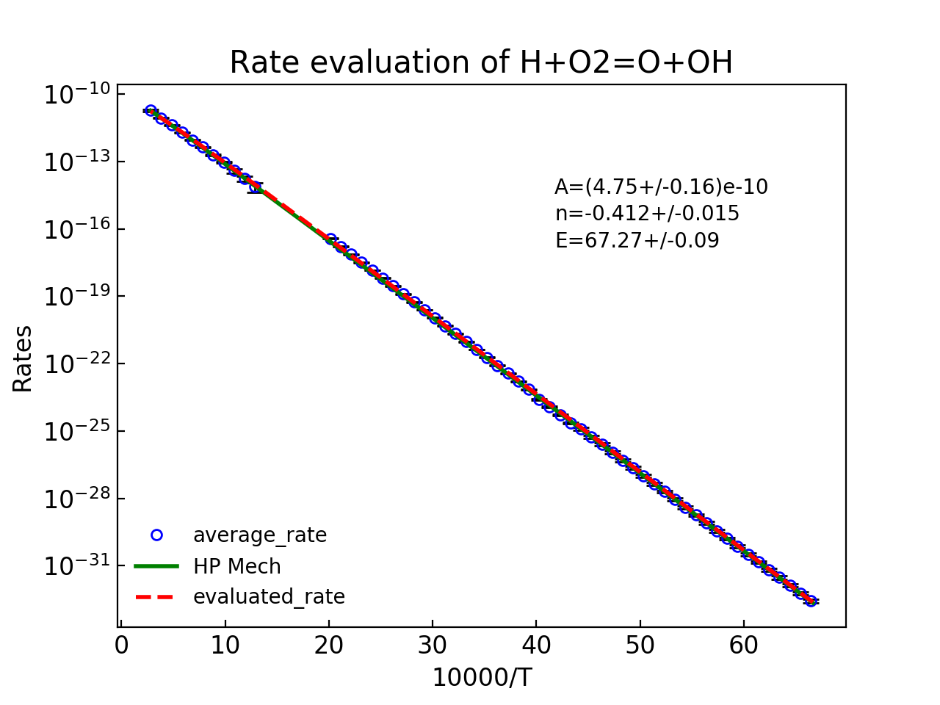
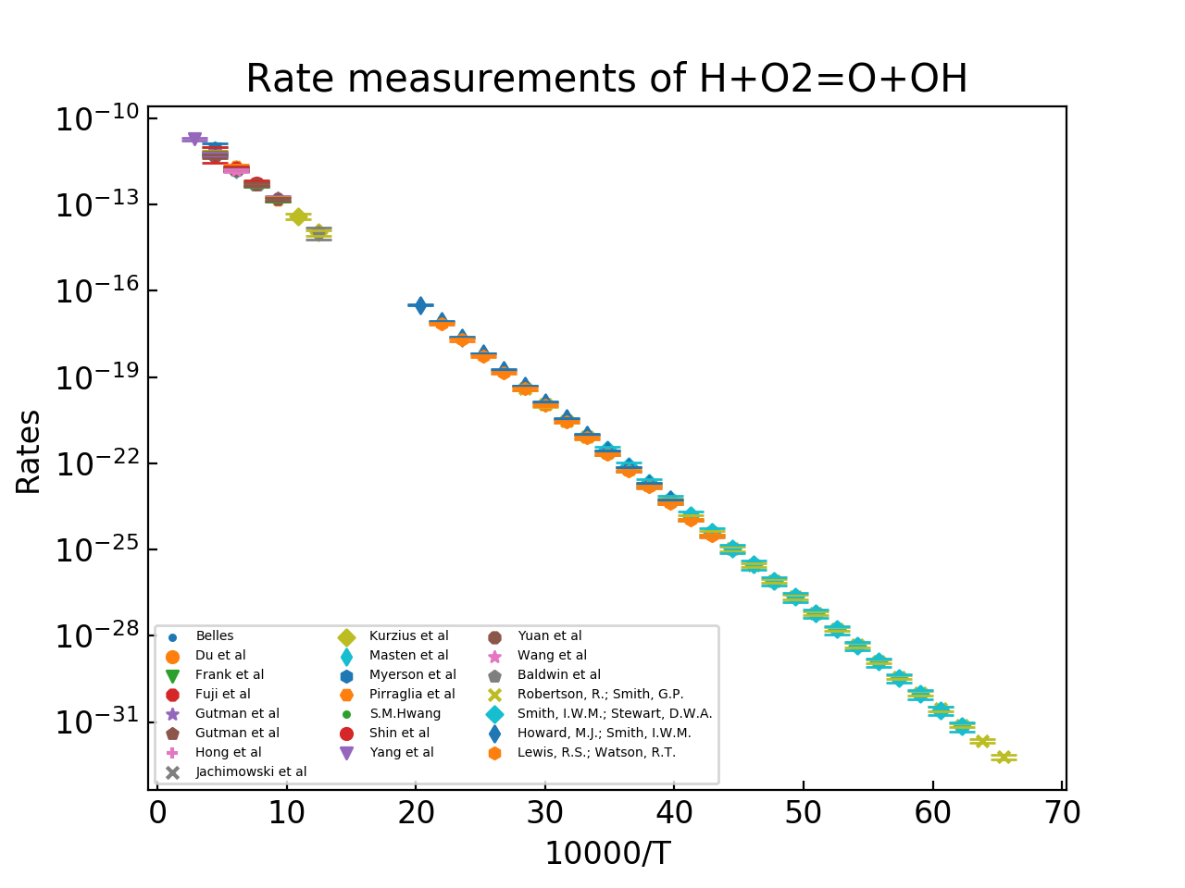
Rate evaluation example: H + O₂ = O + OH reaction
A: 4.75(±0.36)E-09 cm³/molecule/s
n: -0.412 (±0.015)
E: 67.27(±0.09) kJoule/mol

Slide 5
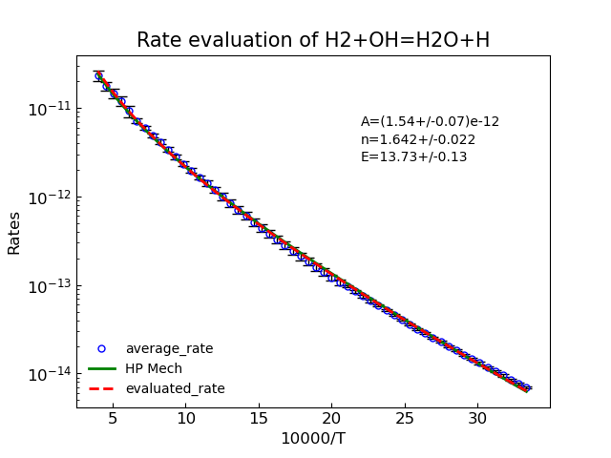
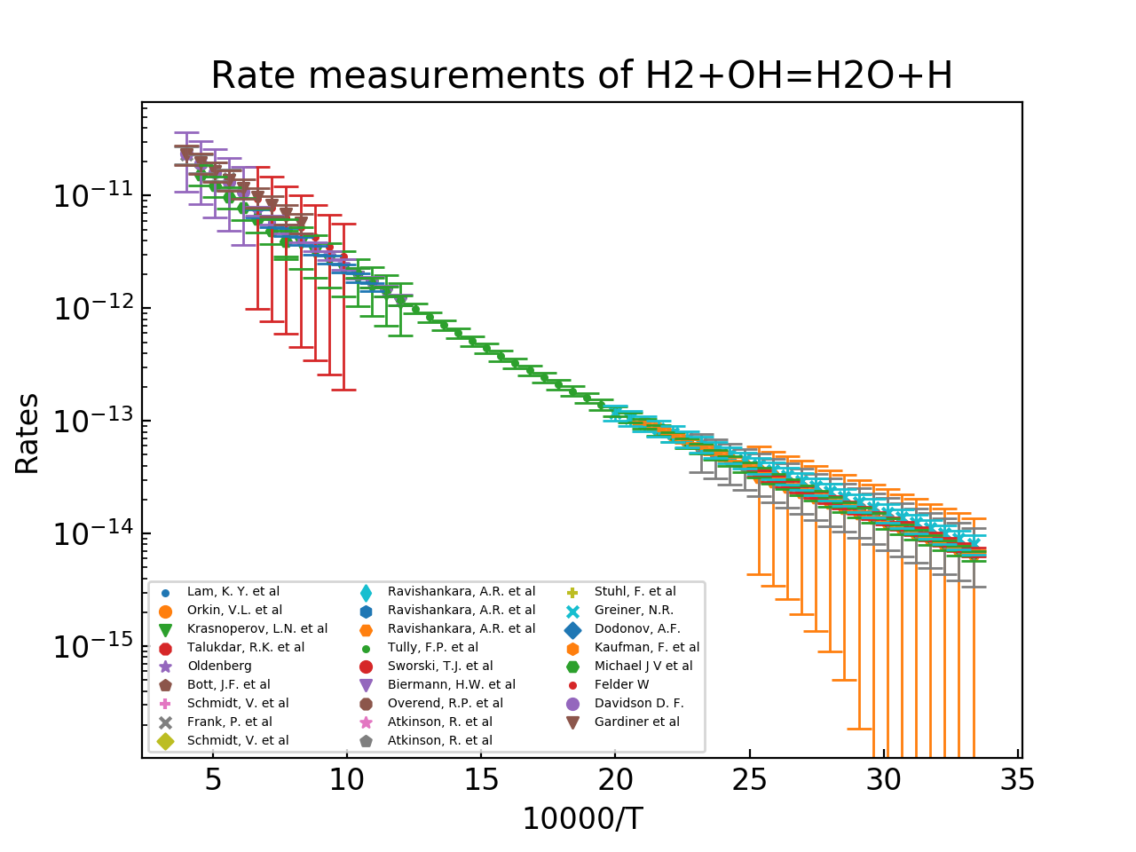
Rate evaluation example: H₂ + OH = H₂O + H reaction
A: 1.57(±0.09)E-12 cm³/molecule/s
n: -1.601 (±0.022)
E: 13.73(±0.13) kJoule/mol

Slide 6
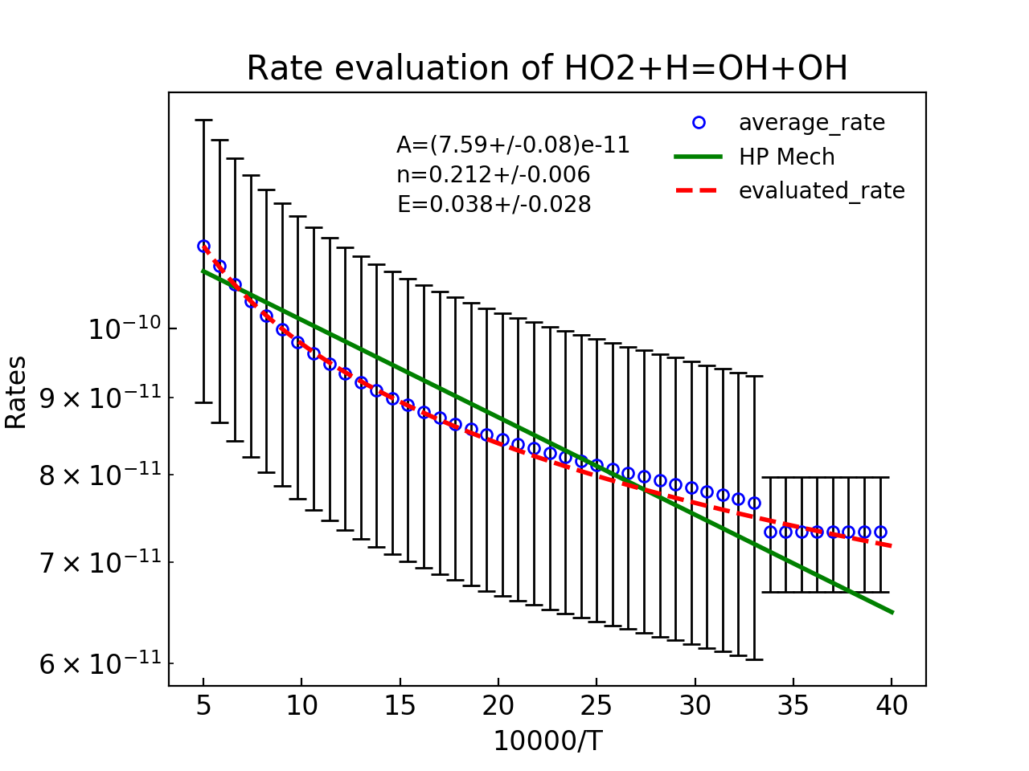
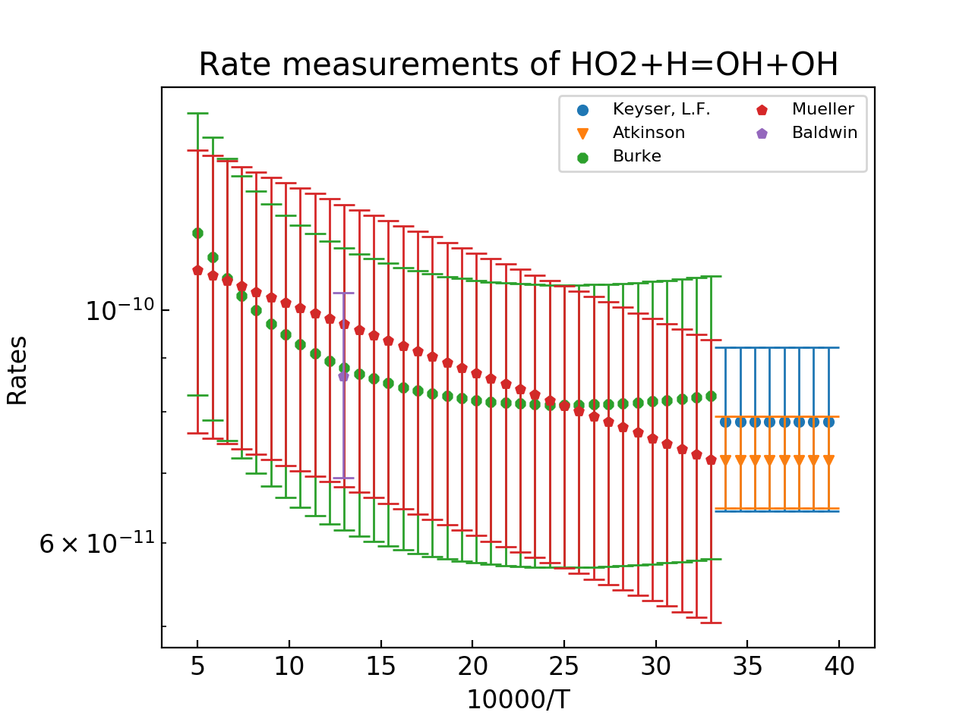
Rate evaluation example: HO₂ + H = OH + OH reaction
A: 7.59(±1.76)E-12 cm³/molecule/s
n: -0.212 (±0.006)
E: 0.038(±0.028) kJoule/mol

Slide 7
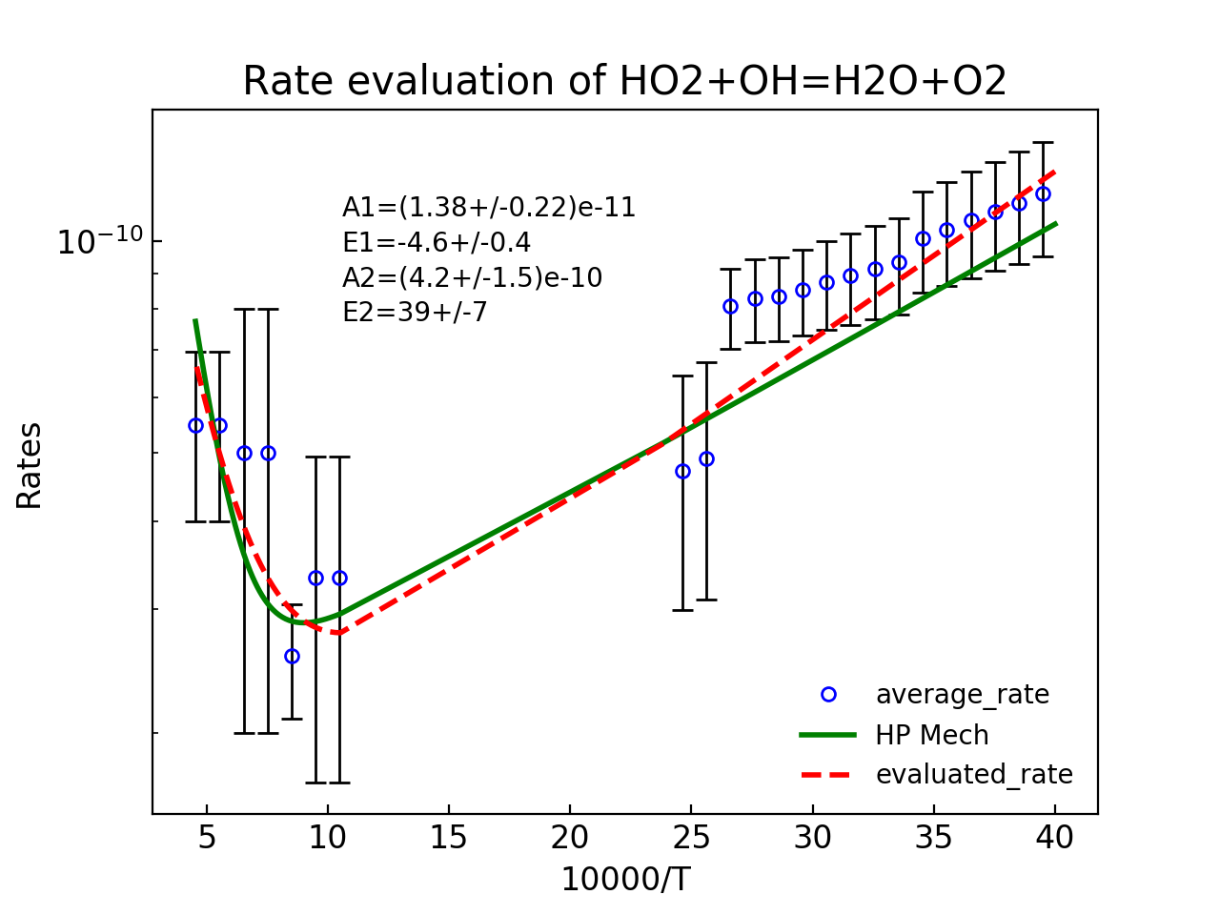
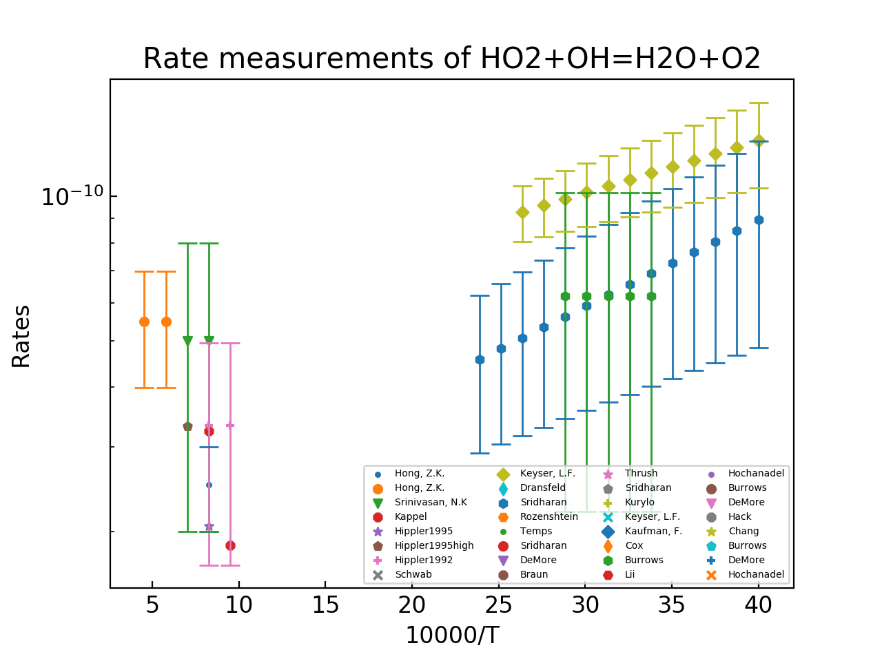
Rate evaluation example: HO₂ + OH = O₂ + H₂O reaction
A1: 1.38(±0.22)E-11 cm³/molecule/s
E1: -4.60(±0.40) kJoule/mol
A2: 4.20(±1.50)E-10 cm³/molecule/s
E2: 39.00(±7.00) kJoule/mol

Slide 8
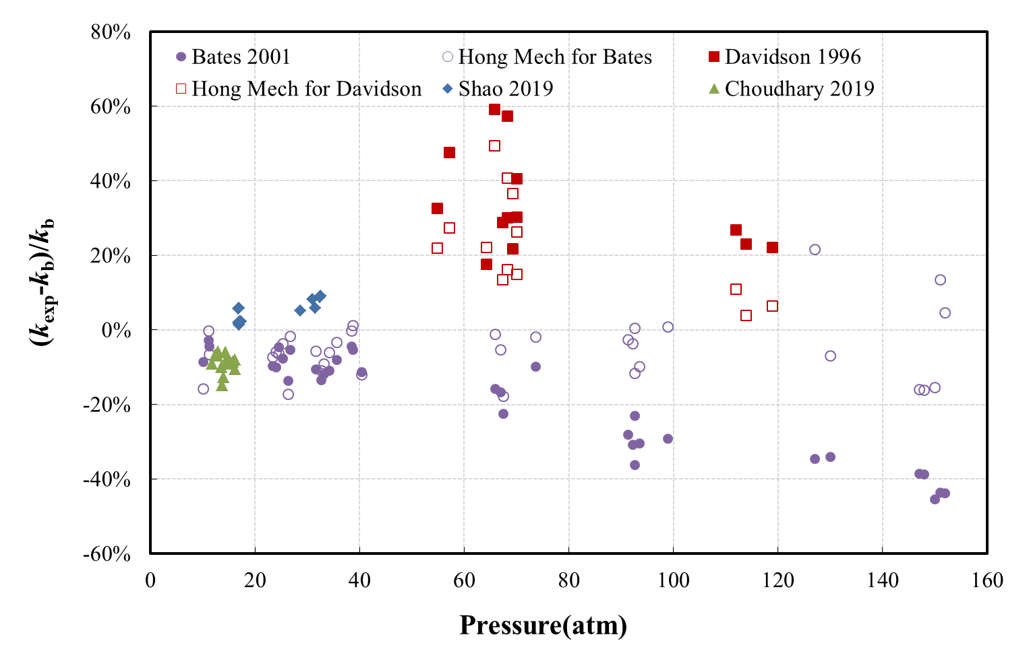
Rate evaluation example: H + O₂ + M= HO₂ + M reaction
H + O₂ (+AR) = HO₂ (+AR) 1.025E+120.604 -241.1
LOW /2.220 (±0.420) E+19 -1.309 278.2/
TROE /0.481 1.0E-10 1.0E+30 1.0E+30/

Slide 9
Use flow reactor data to constrain and optimize kinetics
Flow reactor yields unique targets to constrain kinetics by providing zero dimension in time and one dimension in space vs shock tube zero dimension in space and one dimension in time. Flow reactor condition are generally 800-1000K and 1 -30 bar which fit perfectly in high pressure combustion regime.
Experiment and kinetic modeling of flow reactor experiment always exhibit a shift in the induction period. This is the challenge and draw back for flow reactor.
Gradient in species profile can be directly related to elementary reaction rates, which has been well documented and accepted in the community. In one of the most recent accurate shock tube experiment on H+O2 = O + OH, Hong et al used the gradient in species profile rather than absolute time history profile to derive the rate.
How to utilize the gradient in species profile acquired in high-fidelity flow reactor data?

Slide 10
Improved Method of Uncertainty Minimization with Polynomial Chaos Expansions (MUM-PCE)
Flow reactor speciation measurement uncertainty set as 5%
Overlap the simulation and experiment at the state with 50% fuel consumption where the gradient is biggest
The original Li mech can well capture the trend from the experiment but still not quantitatively satisfactory
Based on MUM-PCE (Sheen & Wang 2010), we improved the uncertainty constraint code to make it more physically interpretable.
Results shows ~10% reduction of H+O2+M rate reduction provide satisfied agreement between experiment and simulation with simulation uncertainty also plotted. Other rate are also tuned by MUM-PCE. This, however, serves as an example though
Together with other species profiles, the uncertainty of the constructed H2/O2
kinetics can be further minimized

Slide 11
Future plan
Finish H₂-O₂ mechanism with statistical analysis and MUM-PCE by August 2020. Publish first set of results as methodology demonstration
H₂-O₂ mechanism validation against flame speed, JSR, flow reactor, shock tube ignition delay (new H₂O₂+OH theoretical calculation), by mid 2021
Extend mechanism to CH₂O with new experiments (Flame and shock tube), theoretical calculation on HCO + O₂ = HO₂ + CO and HCO decomposition

